Slide 1
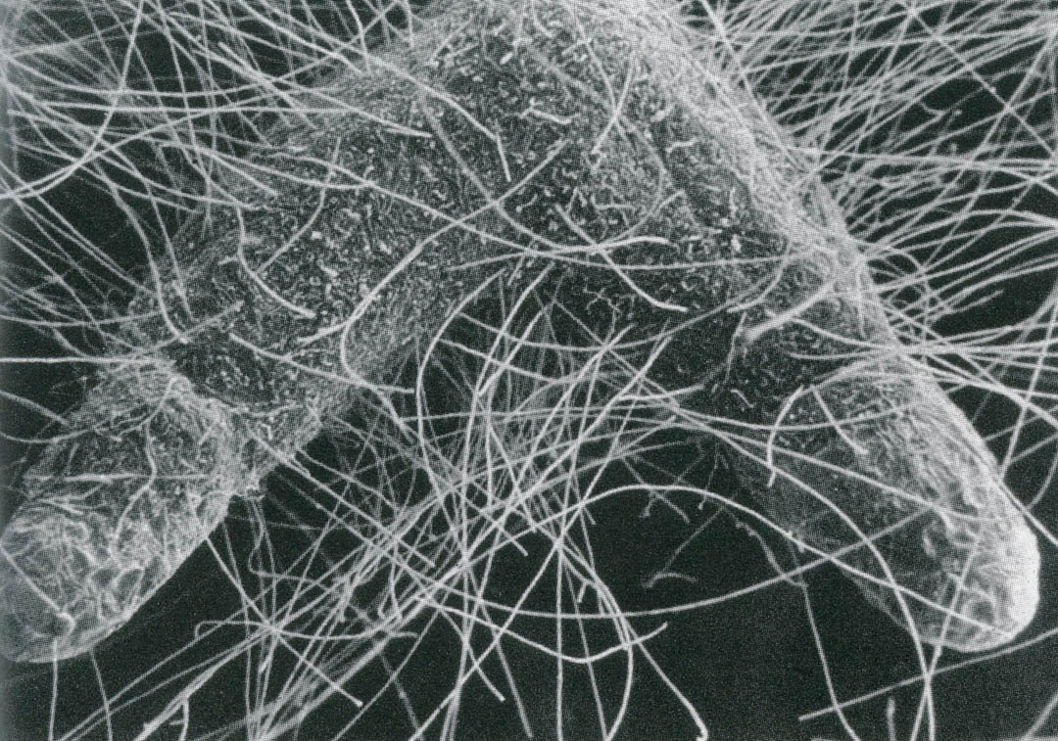
Examining Tamarisk effects on Salix exigua Growth and Fungal Associations
Gabby Garza
Dr. Catherine Gehring

Slide 2
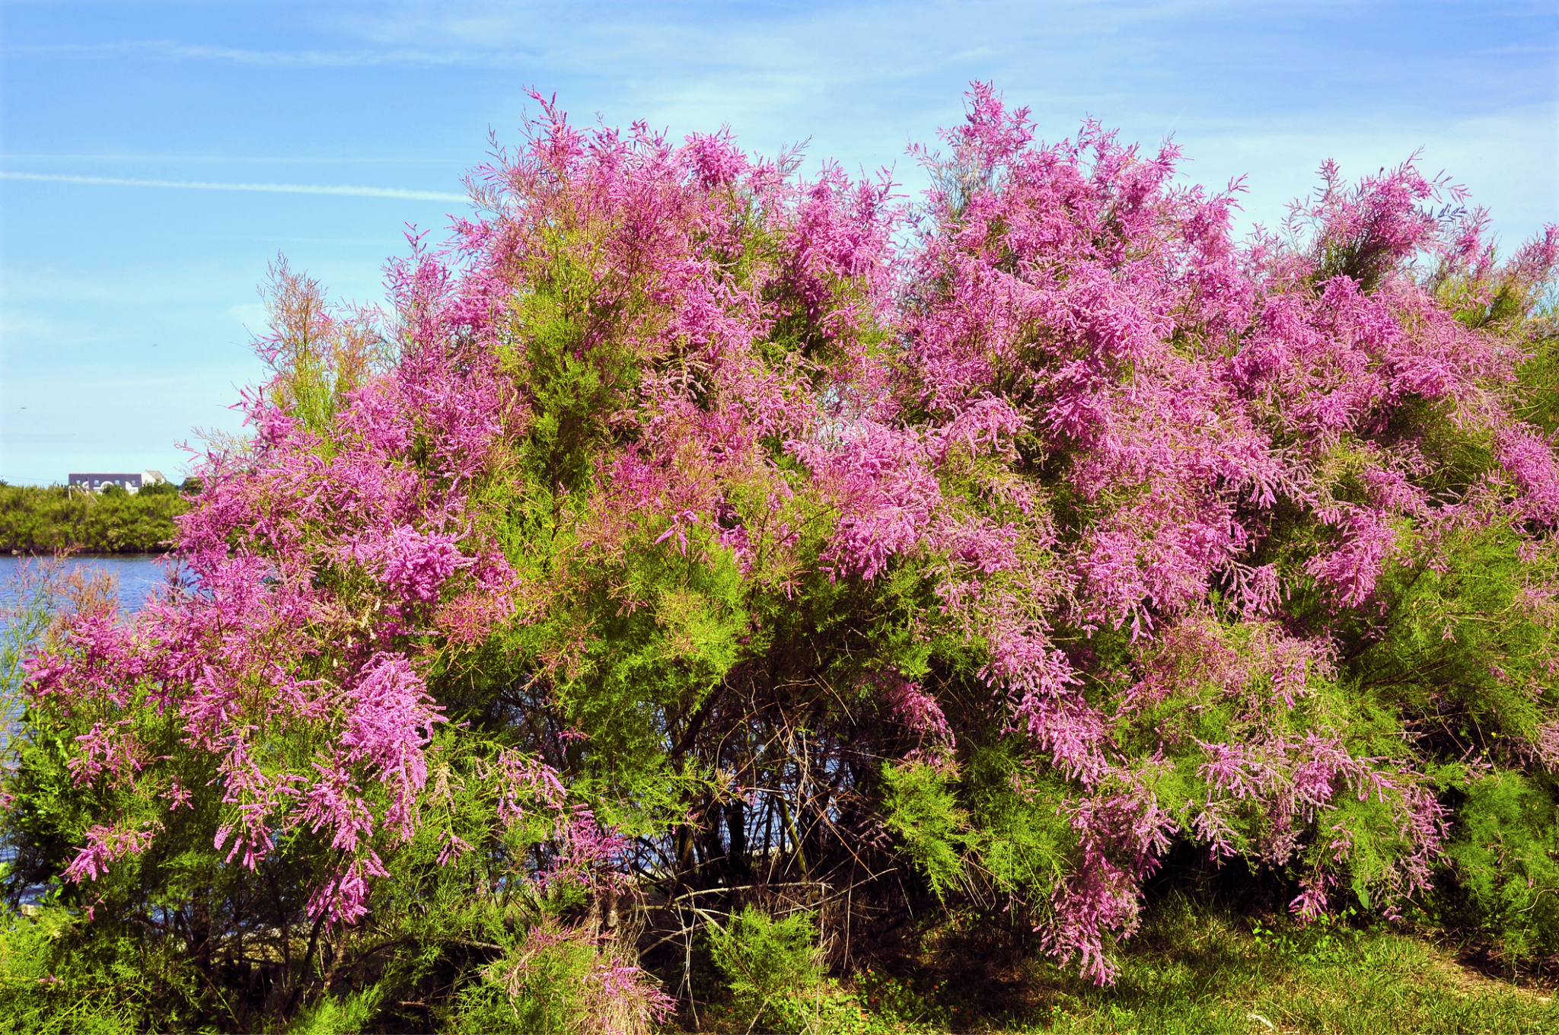
Introduction - Invasive Species
An invasive species is a non native organism that thrives in a new environment.
Invasive species outcompete native species for resources
Difficult to control invasive species
Invasive plant species can change their surrounding environment (soil quality, neighboring species)
Tamarix sp. photo

Slide 3
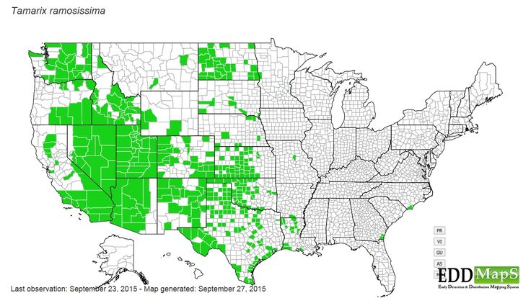
Introduction - Tamarisk
Tamarisk is an invasive shrub species in the United States
Worst weed in the west
Grows alongside streams and rivers
Tolerates drought
Changes the soil chemically & biologically
Chemical Changes: Tamarisk increases soil salinity (salt percentage)
Biological Changes: Tamarisk alters mycorrhizal fungi associations
Tamarix sp. photo

Slide 4
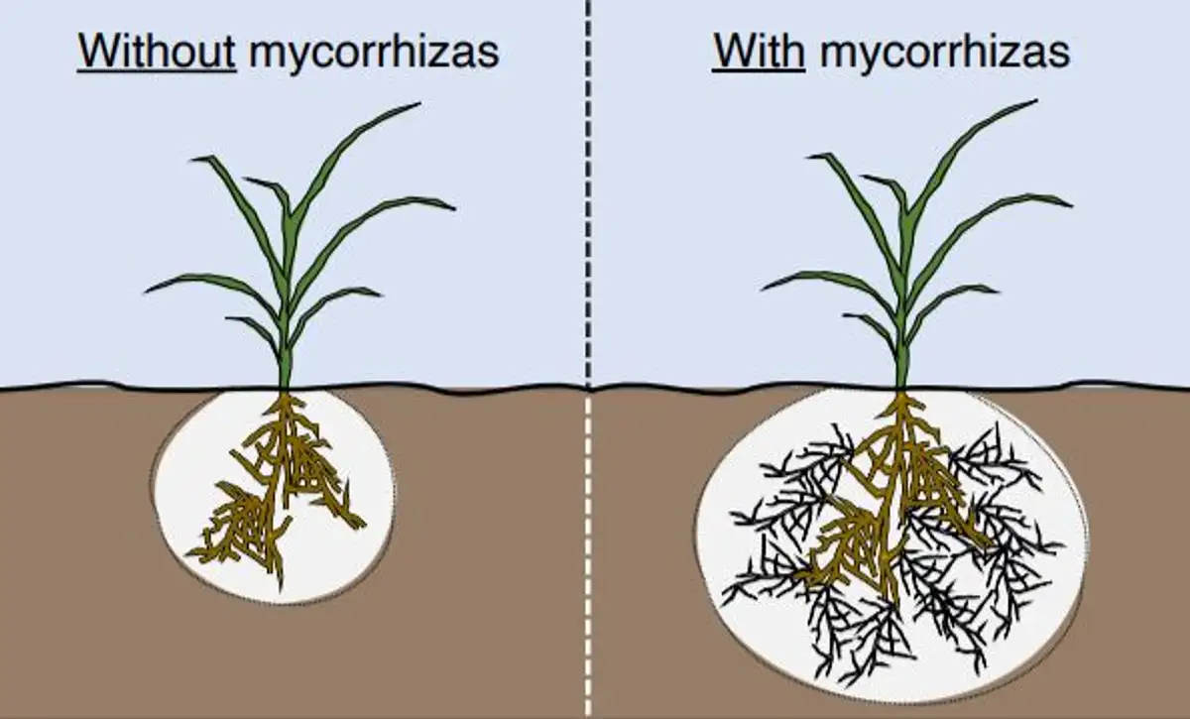
Introduction - Mycorrhizal Fungi
Mycorrhizae are beneficial associations between plant roots and fungi
Mycorrhizal fungi and plants have a mutualistic relationship
Ectomycorrhizal fungi (EMF) : Wrap around plant root for nutrient exchange
Tamarisk do not need fungi to thrive

Slide 5
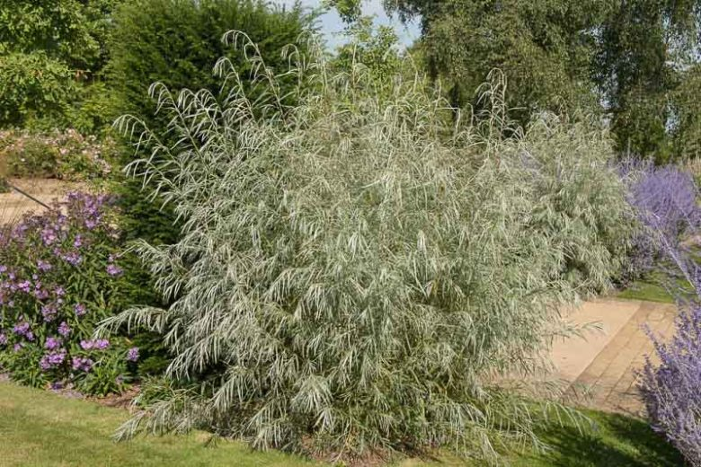
Project Description
Project Question - How does Tamarisk affect the growth and fungal associations of Salix exigua (coyote willow) in Moab, Utah
Coyote Willow Photo

Slide 6
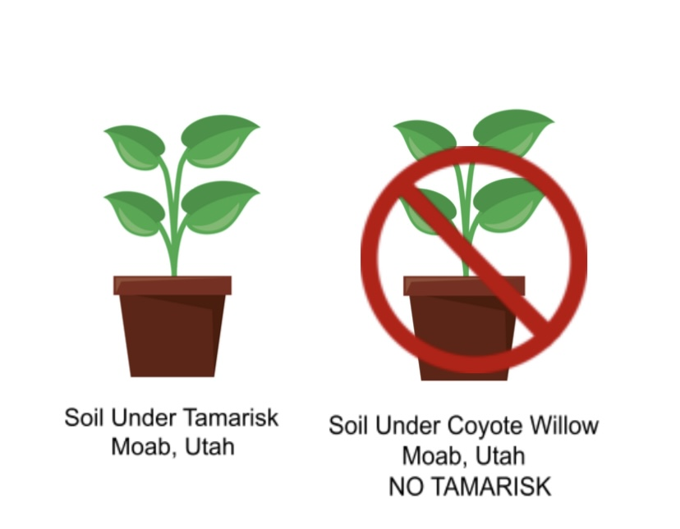
Project Description - Methods
Obtained 2 soil types:
Soil near Tamarisk plant
Soil away from Tamarisk
Grow Coyote Willow seeds in 60 potted plants. Half of the plants are grown in Tamarisk soil, half are grown in non Tamarisk soil.
Harvest willows once large enough ~ approx. 6 months
Examine the willows to analyze EMF abundance and plant size.
Soil was collected near Moab, Utah

Slide 7
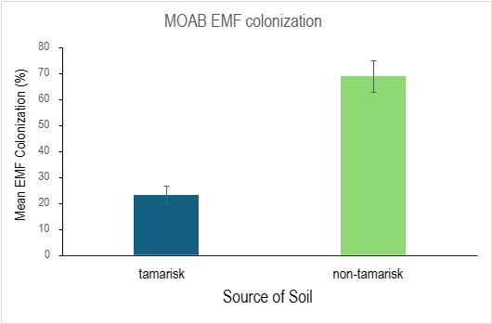
Results - Root Composition
Willows grown in Tamarisk soil developed fewer EMF associations than other group
Aligns with results of Cottonwood & Tamarisk experiment

Slide 8
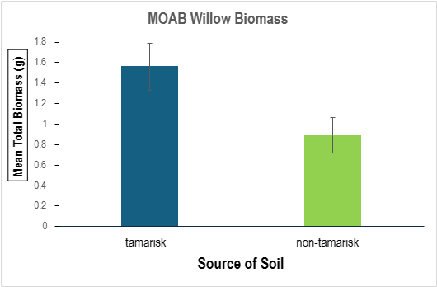
Results - Biomass Analysis
Willows grown in Tamarisk soil had larger root and shoot biomass in comparison to other group
One Hypothesis: Tamarisk increases soil nutrients, therefore willows grown in Tamarisk soil do not require as many EMF for gathering nutrients

Slide 9
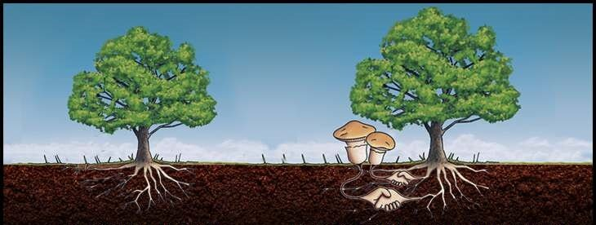
Results - Meaning
Mycorrhizal fungi help plants obtain nutrients
Plants with Mycorrhizal fungi typically have a smaller root biomass and larger shoot
Plants without Mycorrhizal fungi typically have a larger root biomass and smaller shoots

Slide 10
Conclusion
Complete analysis of a second site (Grand Junction, CO)
Discuss other potential hypothesis on Tamarisk results
Willows and restoration
Future Direction
Tamarisk causes changes to surrounding soil composition - decreases mycorrhizal fungi
Tamarisk causes less mycorrhizal fungal associations to form on neighboring plants
Tamarisk causes Salix exigua to have larger root / shoot masses - cause is unknown

Slide 11
References
Citations
Thank you to Dr.Catherine Gehring for being my Mentor this past year
Thank you to the research team for their invaluable contribution to the project (Rivers Edge West, CSU)
Thank you to the NASA / Space Grant Organization for funding my education
Tamarisk. Northern Arizona Invasive Plants. (n.d.). https://nazinvasiveplants.org/tamarisk
What is Tamarisk?. What is tamarisk? | U.S. Geological Survey. (n.d.). https://www.usgs.gov/faqs/what-tamarisk
Mycorrhizal fungi / RHS gardening. / RHS Gardening. (n.d.). https://www.rhs.org.uk/biodiversity/mycorrhizal-fungi

